Slide 1
Supervised Learning and Linear Regression

Slide 2
Classification
In Machine Learning and Statistics, Classification is the problem of identifying to which of a set of categories (subpopulations), a new observation belongs, on the basis of a training set of data containing observations and whose categories membership is known.
Types of Classification
Classification is of two types:
Binary Classification:
When we have to categorize given data into 2 distinct classes. Example – On the basis of given health conditions of a person, we have to determine whether the person has a certain disease or not.
Multiclass Classification:
The number of classes is more than 2. For Example – On the basis of data about different species of flowers, we have to determine which specie does our observation belongs to.

Slide 3
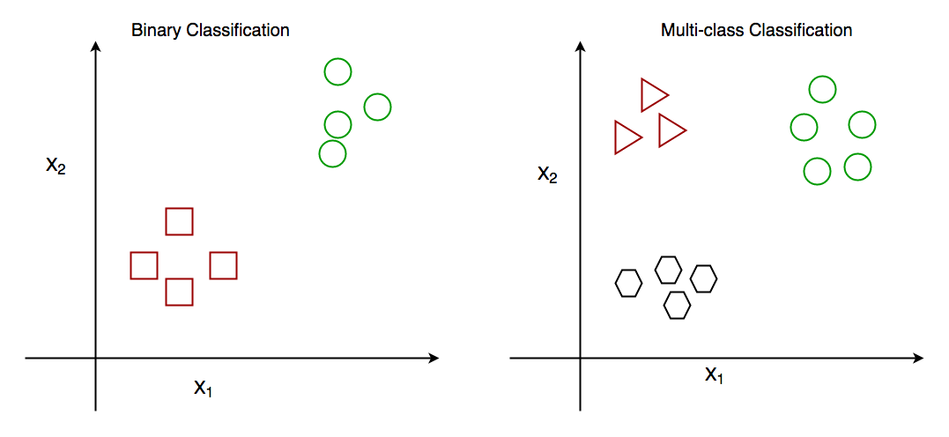

Slide 4
How does classification works?
Suppose we have to predict whether a given patient has a certain disease or not, on the basis of 3 variables, called features.
This means there are two possible outcomes:
The patient has the said disease. Basically, a result labeled “Yes” or “True”.
The patient is disease-free. A result labeled “No” or “False”.
This is a binary classification problem.
We have a set of observations called training data set, which comprises sample data with actual classification results. We train a model, called Classifier on this data set, and use that model to predict whether a certain patient will have the disease or not.

Slide 5
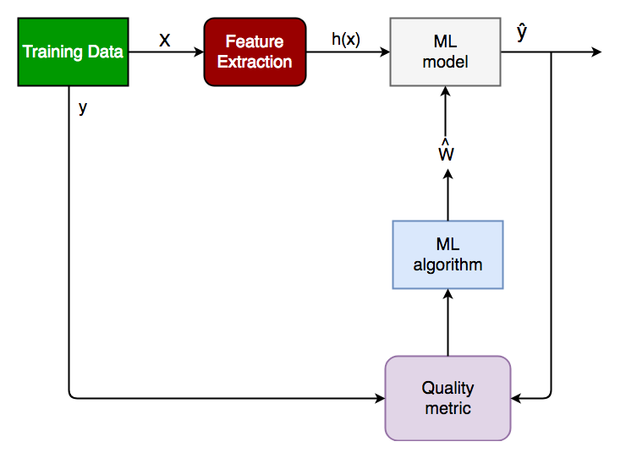
The outcome, thus now depends upon :
How well these features are able to “map” to the outcome.
The quality of our data set. By quality, I refer to statistical and Mathematical qualities.
How well our Classifier generalizes this relationship between the features and the outcome.
The values of the x1 and x2.

Slide 6
Generalized Classification Block Diagram.
X: pre-classified data, in the form of a N*M matrix. N is the no. of observations and M is the number of features
y: An N-d vector corresponding to predicted classes for each of the N observations.
Feature Extraction: Extracting valuable information from input X using a series of transforms.
ML Model: The “Classifier” we’ll train.
y’: Labels predicted by the Classifier.
Quality Metric: Metric used for measuring the performance of the model.
ML Algorithm: The algorithm that is used to update weights w’, which update the model and “learns” iteratively.

Slide 7
Regression Analysis in Machine learning
Regression analysis is a statistical method to model the relationship between a dependent (target) and independent (predictor) variables with one or more independent variables.
More specifically, Regression analysis helps us to understand how the value of the dependent variable is changing corresponding to an independent variable when other independent variables are held fixed.
It predicts continuous/real values such as temperature, age, salary, price, etc.
Example: Suppose there is a marketing company A, who does various advertisement every year and get sales on that. The below list shows the advertisement made by the company in the last 5 years and the corresponding sales:

Slide 8
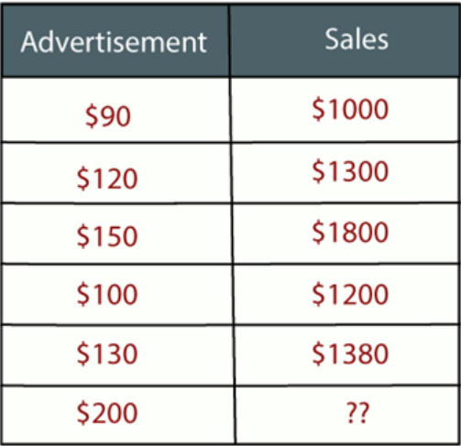
Now, the company wants to do the advertisement of $200 in the year 2019 and wants to know the prediction about the sales for this year.
So to solve such type of prediction problems in machine learning, we need regression analysis.
Regression is a supervised learning technique which helps in finding the correlation between variables and enables us to predict the continuous output variable based on the one or more predictor variables.
It is mainly used for prediction, forecasting, time series modeling, and determining the causal-effect relationship between variables.

Slide 9
Some examples of regression can be as:
Prediction of rain using temperature and other factors
Determining Market trends
Prediction of road accidents due to rash driving.
Terminologies Related to the Regression Analysis:
Dependent Variable:
The main factor in Regression analysis which we want to predict or understand is called the dependent variable. It is also called target variable.
Independent Variable:
The factors which affect the dependent variables or which are used to predict the values of the dependent variables are called independent variable, also called as a predictor.

Slide 10
Outliers:
An outlier is a data point that is noticeably different from the rest. They represent errors in measurement, bad data collection, or simply show variables not considered when collecting the data.
Multicollinearity
Multicollinearity occurs when two or more independent variables(also known as predictor) are highly correlated with one another in a regression model.
This means that an independent variable can be predicted from another independent variable in a regression model
Let us take a simple example from our everyday life to explain this. Assume that we want to fit a regression model using the independent features such as pocket money and father income
Here both independent variables are highly correlated means as father income increases pocket money also increases and if father income decreases pocket money also decreases.

Slide 11
Underfitting and Overfitting:
If our algorithm works well with the training dataset but not well with test dataset, then such problem is called Overfitting. And if our algorithm does not perform well even with training dataset, then such problem is called underfitting.
Why do we use Regression Analysis?
Regression analysis helps in the prediction of a continuous variable.
There are various scenarios in the real world where we need some future predictions such as weather condition, sales prediction, marketing trends, etc., for such case we need some technology which can make predictions more accurately.
So for such case we need Regression analysis which is a statistical method and used in machine learning and data science. Below are some other reasons for using Regression analysis:
Regression estimates the relationship between the target and the independent variable.
It is used to find the trends in data.
It helps to predict real/continuous values.
By performing the regression, we can confidently determine the most important factor, the least important factor, and how each factor is affecting the other factors.

Slide 12
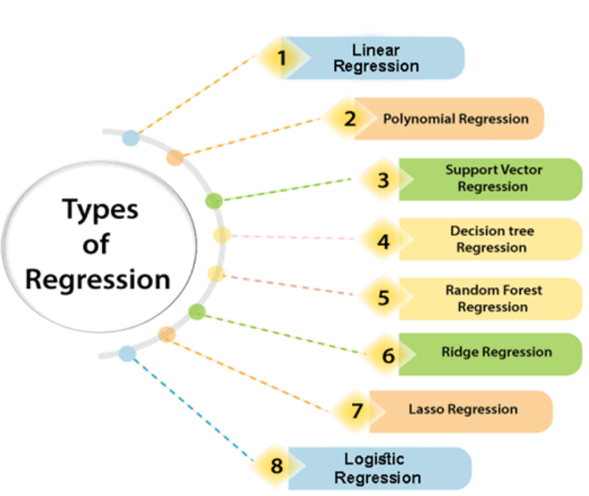
Types of Regression

Slide 13
Linear Regression:
Linear regression is a statistical regression method which is used for predictive analysis.
It is one of the very simple and easy algorithms which works on regression and shows the relationship between the continuous variables.
It is used for solving the regression problem in machine learning.
Linear regression shows the linear relationship between the independent variable (X-axis) and the dependent variable (Y-axis), hence called linear regression.
If there is only one input variable (x), then such linear regression is called simple linear regression. And if there is more than one input variable, then such linear regression is called multiple linear regression.
The relationship between variables in the linear regression model can be explained using the below image. Here we are predicting the salary of an employee on the basis of the year of experience.

Slide 14
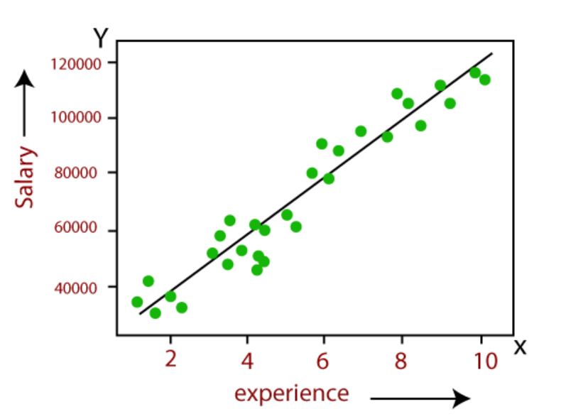
Y= aX+b
Here, Y = dependent variables (target variables),
X= Independent variables (predictor variables),
a and b are the linear coefficients
Some popular applications of linear regression are:
Analyzing trends and sales estimates
Salary forecasting
Real estate prediction
Arriving at ETAs in traffic.

Slide 15
Logistic Regression:
Logistic regression is another supervised learning algorithm which is used to solve the classification problems. In classification problems, we have dependent variables in a binary or discrete format such as 0 or 1.
Logistic regression algorithm works with the categorical variable such as 0 or 1, Yes or No, True or False, Spam or not spam, etc.
It is a predictive analysis algorithm which works on the concept of probability.
Logistic regression is a type of regression, but it is different from the linear regression algorithm in the term how they are used.
Logistic regression uses sigmoid function or logistic function which is a complex cost function. This sigmoid function is used to model the data in logistic regression. The function can be represented as:

Slide 16

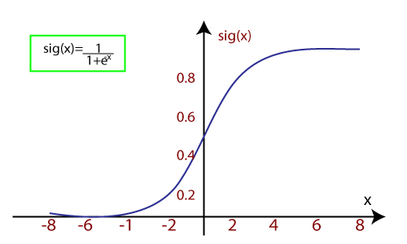
f(x)= Output between the 0 and 1 value.
x= input to the function
e= base of natural logarithm.
It uses the concept of threshold levels, values above the threshold level are rounded up to 1, and values below the threshold level are rounded up to 0.
There are three types of logistic regression:
Binary(0/1, pass/fail)
Multi(cats, dogs, lions)
Ordinal(low, medium, high)

Slide 17
Polynomial Regression:
Polynomial Regression is a type of regression which models the non-linear dataset using a linear model.
It is similar to multiple linear regression, but it fits a non-linear curve between the value of x and corresponding conditional values of y.
Suppose there is a dataset which consists of datapoints which are present in a non-linear fashion, so for such case, linear regression will not best fit to those datapoints. To cover such datapoints, we need Polynomial regression.
In Polynomial regression, the original features are transformed into polynomial features of given degree and then modeled using a linear model. Which means the datapoints are best fitted using a polynomial line.

Slide 18
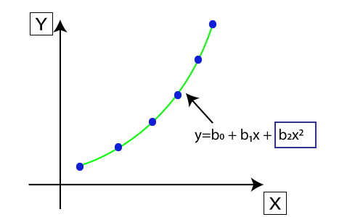
The equation for polynomial regression also derived from linear regression equation that means Linear regression equation Y= b0+ b1x, is transformed into Polynomial regression equation Y= b0+b1x+ b2x2+ b3x3+.....+ bnxn.
Here Y is the predicted/target output, b0, b1,... bn are the regression coefficients. x is our independent/input variable.
The model is still linear as the coefficients are still linear with quadratic

Slide 19
Support Vector Regression:
Support Vector Machine is a supervised learning algorithm which can be used for regression as well as classification problems. So if we use it for regression problems, then it is termed as Support Vector Regression.
Support Vector Regression is a regression algorithm which works for continuous variables. Below are some keywords which are used in Support Vector Regression:
Kernel:
Kernel refers to a method that allows us to apply linear classifiers to nonlinear problems by mapping non-linear data into a higher-dimensional space without the need to visit or understand that higher-dimensional space.
Hyperplane:
Kernel refers to a method that allows us to apply linear classifiers to nonlinear problems by mapping non-linear data into a higher-dimensional space without the need to visit or understand that higher-dimensional space.

Slide 20
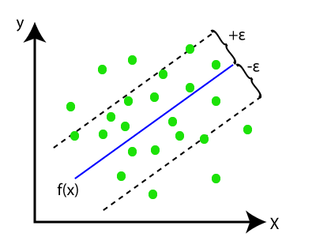
Boundary line:
Boundary lines are the two lines apart from hyperplane, which creates a margin for datapoints.
Support vectors:
Support vectors are the datapoints which are nearest to the hyperplane and opposite class.
In SVR, we always try to determine a hyperplane with a maximum margin, so that maximum number of datapoints are covered in that margin.
The main goal of SVR is to consider the maximum datapoints within the boundary lines and the hyperplane (best-fit line) must contain a maximum number of datapoints.
Here, the blue line is called hyperplane, and the other two lines are known as boundary lines

Slide 21
Decision Tree Regression:
Decision Tree is a supervised learning algorithm which can be used for solving both classification and regression problems.
It can solve problems for both categorical and numerical data.
Decision Tree regression builds a tree-like structure in which each internal node represents the "test" for an attribute, each branch represent the result of the test, and each leaf node represents the final decision or result.
A decision tree is constructed starting from the root node/parent node (dataset), which splits into left and right child nodes (subsets of dataset). These child nodes are further divided into their children node, and themselves become the parent node of those nodes.

Slide 22
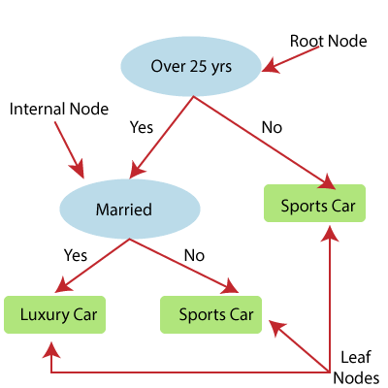
Above image showing the example of Decision Tee regression, here, the model is trying to predict the choice of a person between Sports cars or Luxury car.
Random forest is one of the most powerful supervised learning algorithms which is capable of performing regression as well as classification tasks.
The Random Forest regression is an ensemble learning method which combines multiple decision trees and predicts the final output based on the average of each tree output.
The combined decision trees are called as base models, and it can be represented more formally as:
g(x)= f0(x)+ f1(x)+ f2(x)+....

Slide 23
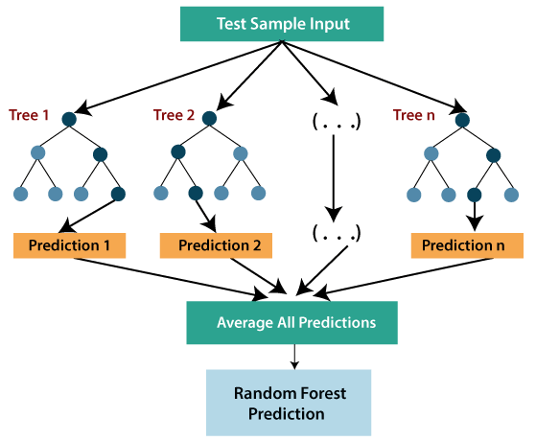

Slide 24

Ridge Regression:
Ridge regression is one of the most robust versions of linear regression in which a small amount of bias is introduced so that we can get better long term predictions.
The amount of bias added to the model is known as Ridge Regression penalty. We can compute this penalty term by multiplying with the lambda to the squared weight of each individual features.
The equation for ridge regression will be:
A general linear or polynomial regression will fail if there is high collinearity between the independent variables, so to solve such problems, Ridge regression can be used.
Ridge regression is a regularization technique, which is used to reduce the complexity of the model. It is also called as L2 regularization.
It helps to solve the problems if we have more parameters than samples.

Slide 25

Lasso Regression:
Lasso regression is another regularization technique to reduce the complexity of the model.
It is similar to the Ridge Regression except that penalty term contains only the absolute weights instead of a square of weights.
Since it takes absolute values, hence, it can shrink the slope to 0, whereas Ridge Regression can only shrink it near to 0.
It is also called as L1 regularization. The equation for Lasso regression will be:

Slide 26
SIMPLE LINEAR REGRESSION
Simple Linear Regression is a type of Regression algorithms that models the relationship between a dependent variable and a single independent variable.
The relationship shown by a Simple Linear Regression model is linear or a sloped straight line, hence it is called Simple Linear Regression.
The key point in Simple Linear Regression is that the dependent variable must be a continuous/real value. However, the independent variable can be measured on continuous or categorical values.
Simple Linear regression algorithm has mainly two objectives:
Model the relationship between the two variables. Such as the relationship between Income and expenditure, experience and Salary, etc.
Forecasting new observations. Such as Weather forecasting according to temperature, Revenue of a company according to the investments in a year, etc.

Slide 27
Simple Linear Regression Model:
The Simple Linear Regression model can be represented using the below equation:
y= a0+a1x+ ε
Where,
a0= It is the intercept of the Regression line (can be obtained putting x=0)
a1= It is the slope of the regression line, which tells whether the line is increasing or decreasing.
ε = The error term. (For a good model it will be negligible)

Slide 28
Implementation of Simple Linear Regression Algorithm using Python
Problem Statement example for Simple Linear Regression:
Here we are taking a dataset that has two variables: salary (dependent variable) and experience (Independent variable). The goals of this problem is:
We want to find out if there is any correlation between these two variables
We will find the best fit line for the dataset.
How the dependent variable is changing by changing the independent variable.
Step-1: Data Pre-processing
The first step for creating the Simple Linear Regression model is data pre-processing.
First, we will import the three important libraries, which will help us for loading the dataset, plotting the graphs, and creating the Simple Linear Regression model.
import numpy as nm
import matplotlib.pyplot as mtp
import pandas as pd
Next, we will load the dataset into our code:
data_set= pd.read_csv(‘employee.csv')

Slide 29
After that, we need to extract the dependent and independent variables from the given dataset. The independent variable is employee_id, and the dependent variable is salary. Below is code for it:
x= data_set.iloc[:, :0].values
y= data_set.iloc[:, 7].values
In the above lines of code, for x variable, we have taken 0 value since we want to remove the last column from the dataset.
For y variable, we have taken 1 value as a parameter, since we want to extract the second column and indexing starts from the zero.
Next, we will split both variables into the test set and training set.
We have 30 observations, so we will take 20 observations for the training set and 10 observations for the test set.
We are splitting our dataset so that we can train our model using a training dataset and then test the model using a test dataset.
from sklearn.model_selection import train_test_split
x_train, x_test, y_train, y_test= train_test_split(x, y, test_size= 1/3, random_state=0)

Slide 30
Step-2: Fitting the Simple Linear Regression to the Training Set:
Now the second step is to fit our model to the training dataset. To do so, we will import the LinearRegression class of the linear_model library from the scikit learn. After importing the class, we are going to create an object of the class named as a regressor.
from sklearn.linear_model import LinearRegression
regressor= LinearRegression()
regressor.fit(x_train, y_train)
We have used a fit() method to fit our Simple Linear Regression object to the training set.
In the fit() function, we have passed the x_train and y_train, which is our training dataset for the dependent and an independent variable.
We have fitted our regressor object to the training set so that the model can easily learn the correlations between the predictor and target variables.

Slide 31
Prediction of test set result:
Dependent (Empid) and an independent variable (Salary). So, now, our model is ready to predict the output for the new observations. In this step, we will provide the test dataset (new observations) to the model to check whether it can predict the correct output or not.
We will create a prediction vector y_pred, and x_pred, which will contain predictions of test dataset, and prediction of training set respectively.
y_pred= regressor.predict(x_test)
x_pred= regressor.predict(x_train)

Slide 32
Step: 4. visualizing the Training set results
We will visualize the training set result. To do so, we will use the scatter() function of the pyplot library, which we have already imported in the pre-processing step.
The scatter () function will create a scatter plot of observations
In the x-axis, we will plot the employee _id of employees and on the y-axis, salary of employees.
In the function, we will pass the real values of training set, which means a emp id x_train, training set of Salaries y_train, and color of the observations.
Here we are taking a green color for the observation, but it can be any color as per the choice.

Slide 33
After that, we will assign labels for x-axis and y-axis using xlabel() and ylabel() function.
mtp.scatter(x_train, y_train, color="green")
mtp.plot(x_train, x_pred, color="red")
mtp.title("Salary vs Employee_id(Training Dataset)")
mtp.xlabel(“Employee_id")
mtp.ylabel("Salary(In Rupees)")
mtp.show()
Visualizing the Test set results:
mtp.scatter(x_test, y_test, color="blue")
mtp.plot(x_train, x_pred, color="red")
mtp.title("Salary vs Employee_id (Test Dataset)")
mtp.xlabel(“Employee_id")
mtp.ylabel("Salary(In Rupees)")
mtp.show()

